Slide 1
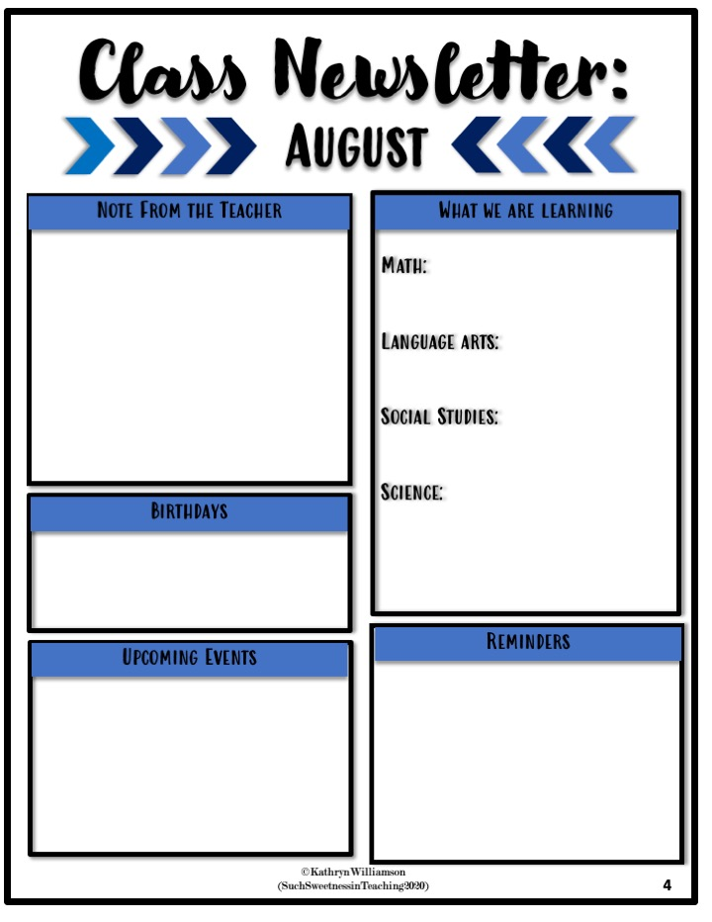
Dear Parent/Guardian,
Please continue to discuss the importance of following classroom and school rules with your child.
-Students are considered tardy after 8:20 a.m.
-Please ensure teachers have current contact information on file. Check PowerSchool for accurate information.
. Visit the Richland website to see teacher’s pages. -Students should be picked up from school by 3:15 p.m.
.
Divion- How many in each group? How many groups?
Math- Multiplication Facts: Use Patterns
Vocabulary
-multiples
-Identity(one) Property of Multiplication
-Zero Property of Multiplication
Ask and Answer Questions, Sentences/Fragments, CK spelling
Geography of TN
Properties of Matter
Dominic
Habor Royre
Sharan Simon
Class Dojo is our method of communication. If you have a time sensitive message (like a dismissal change) please let the office know!
Mrs. Jones - jonesa16@scsk12.org
Ms. Smith - smiths28@scsk12.org
Mr. Colley - colleya@scsk12.org

